Slide 1

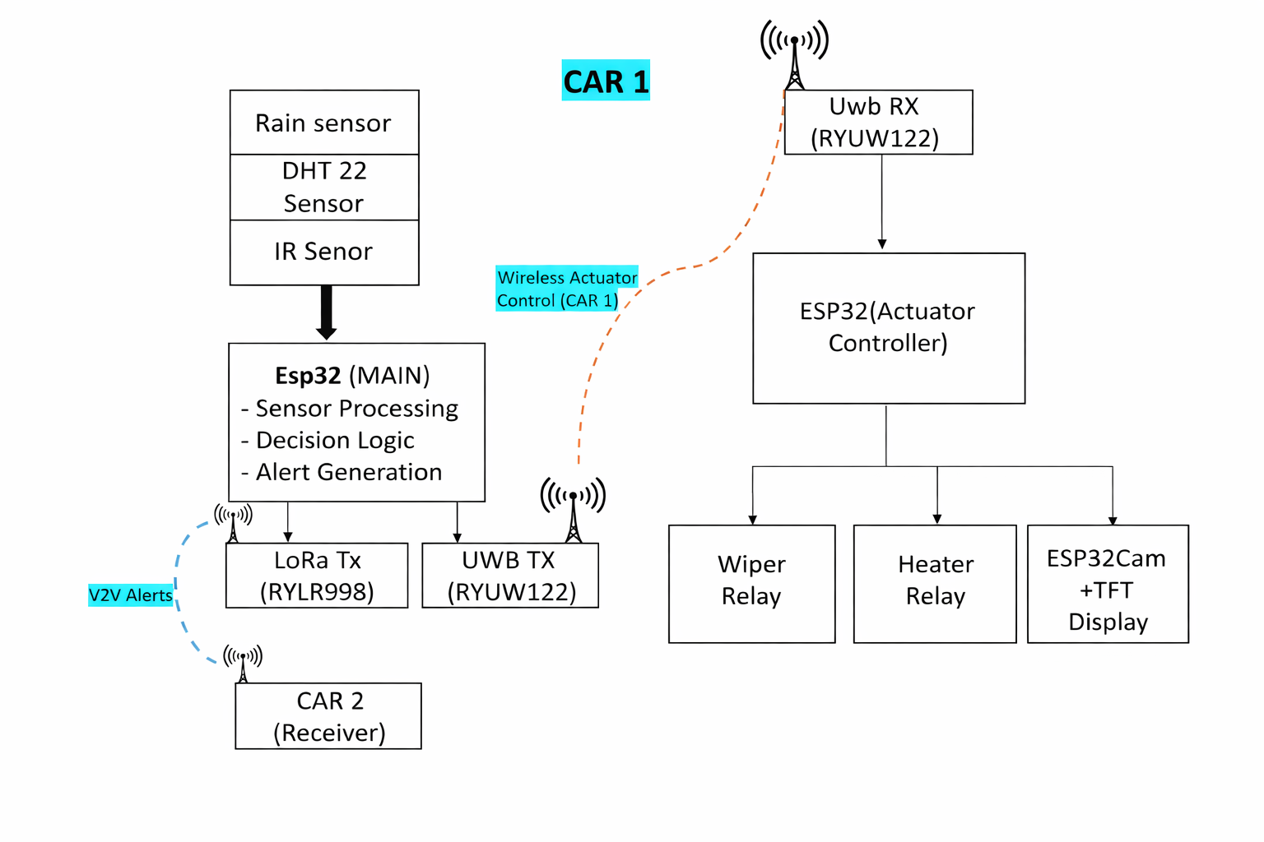
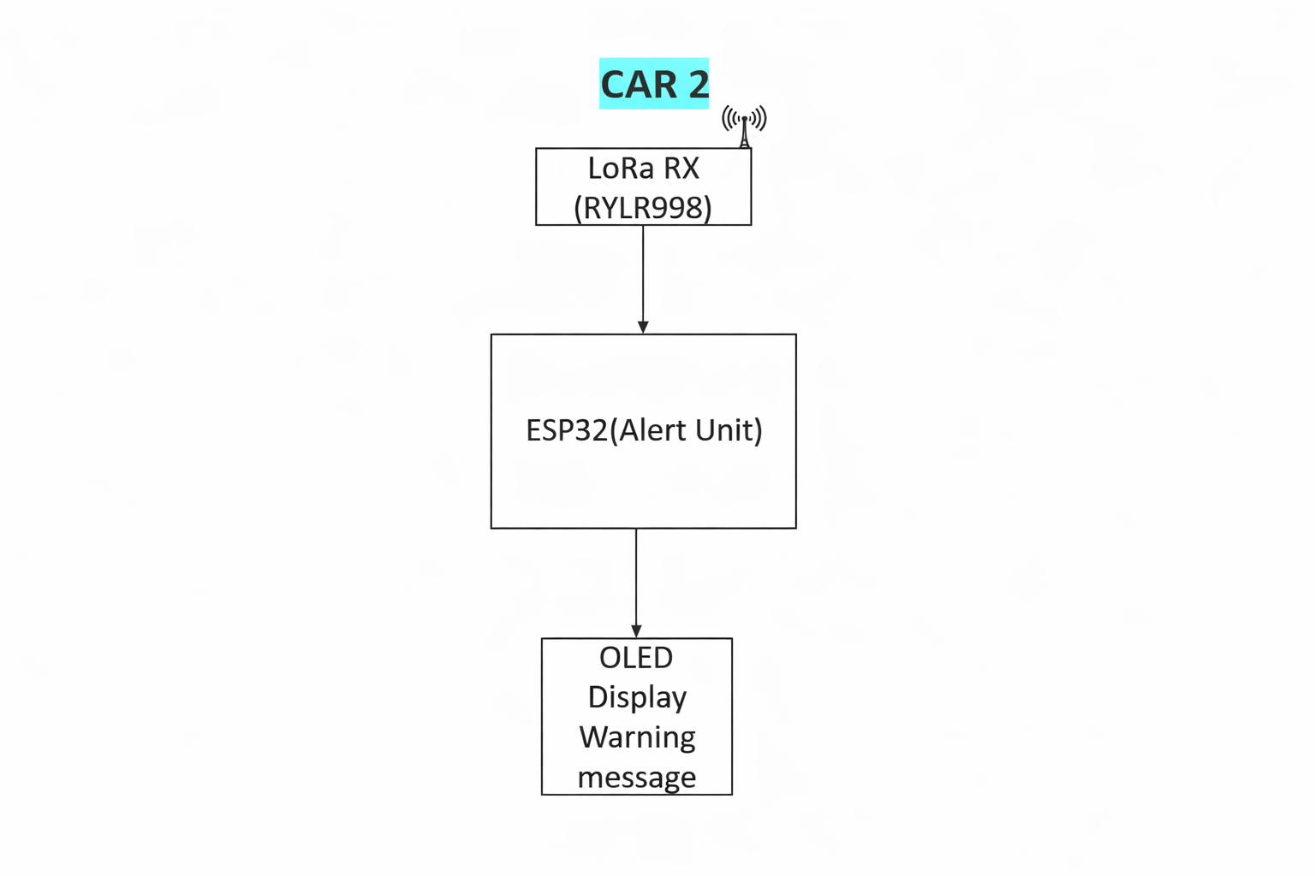
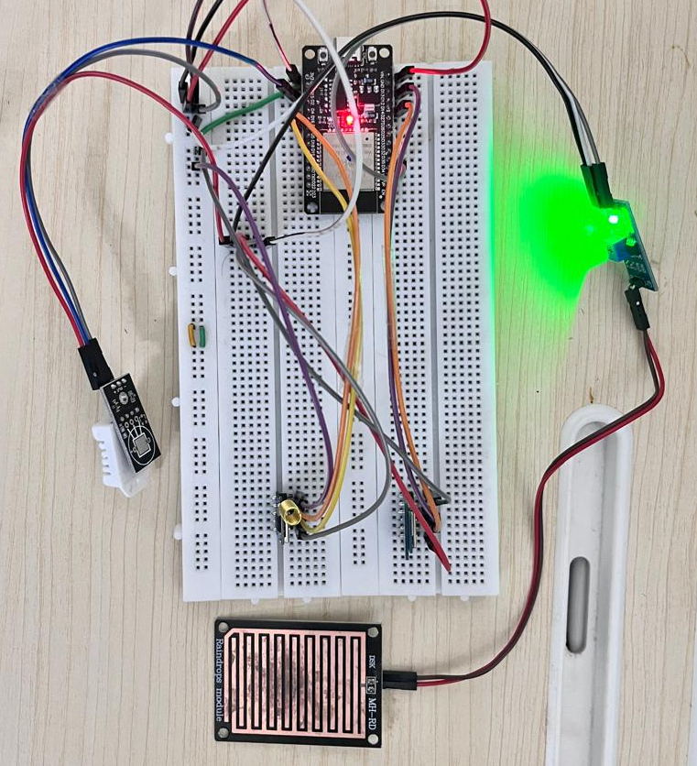
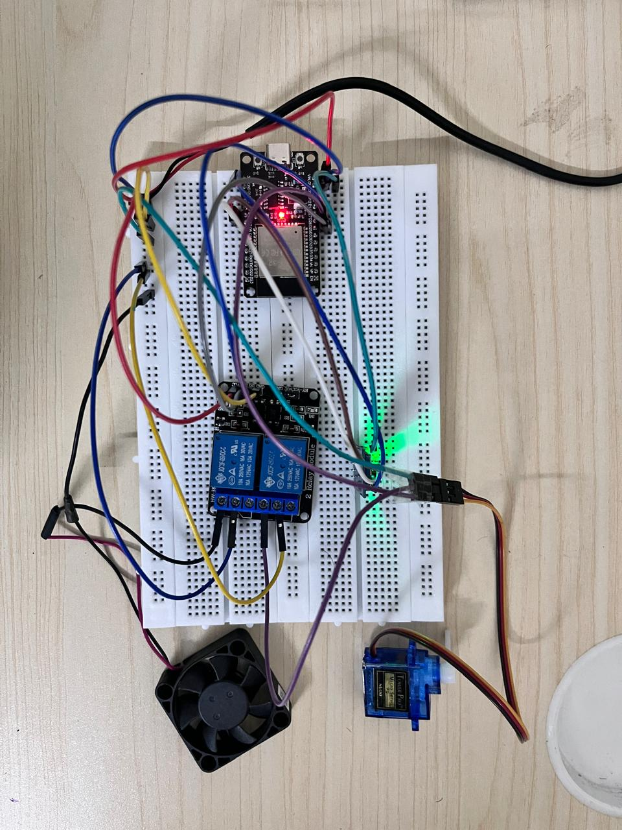
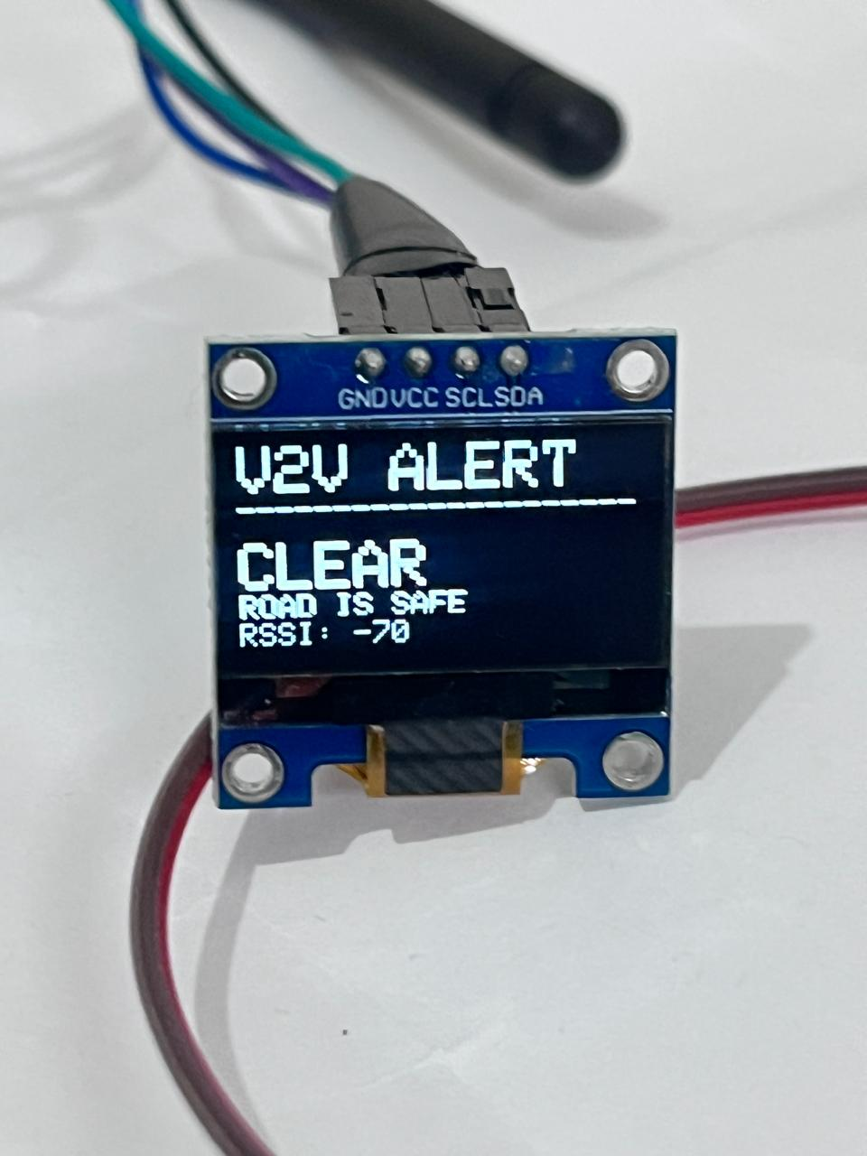
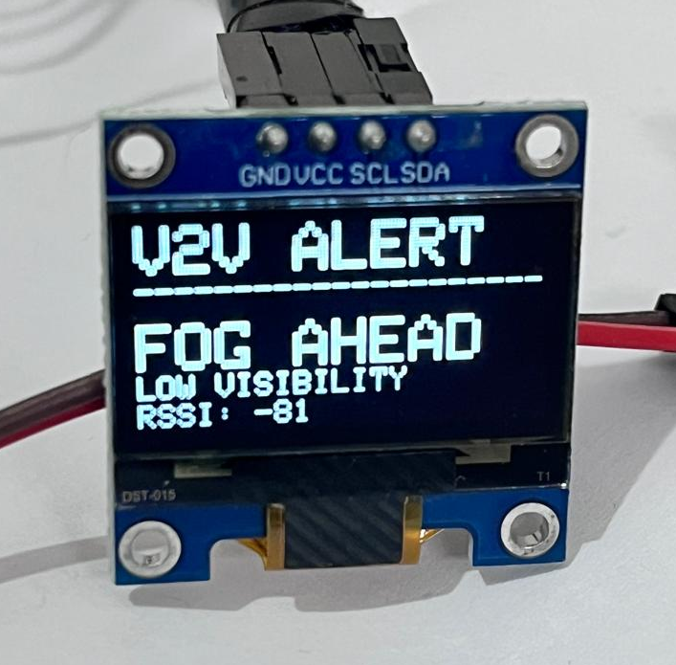


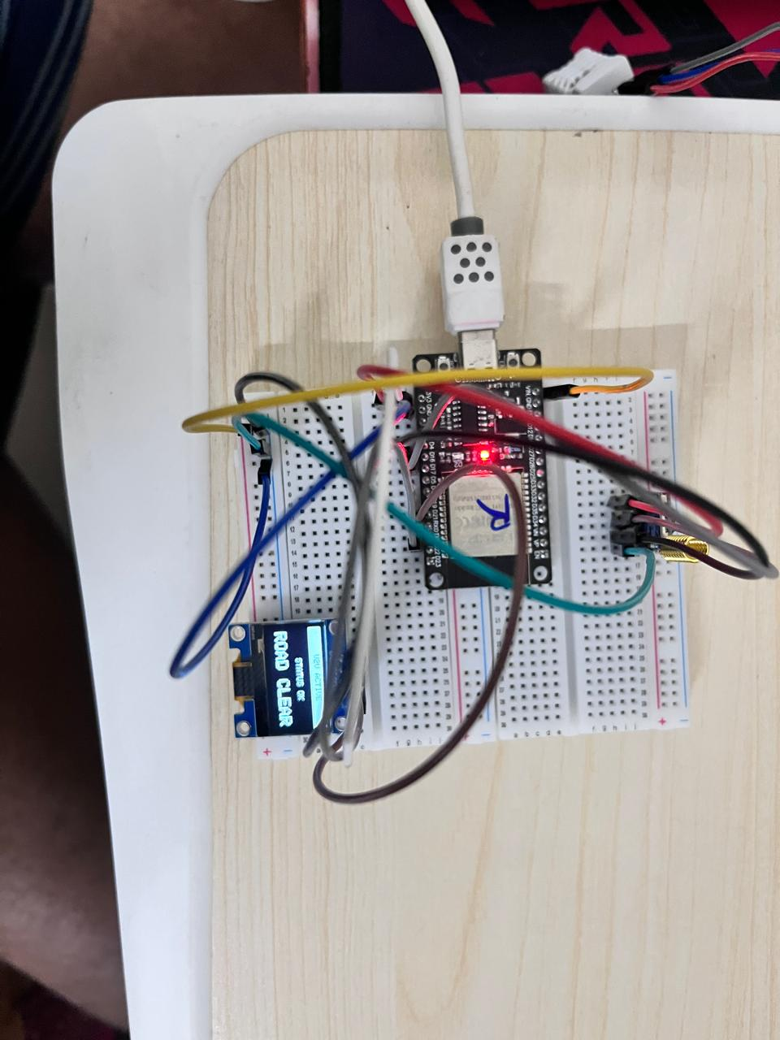

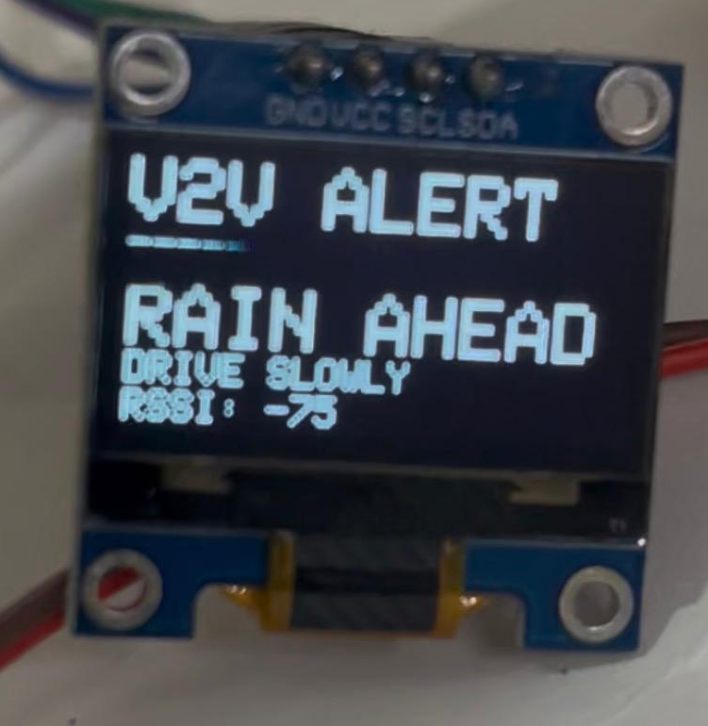
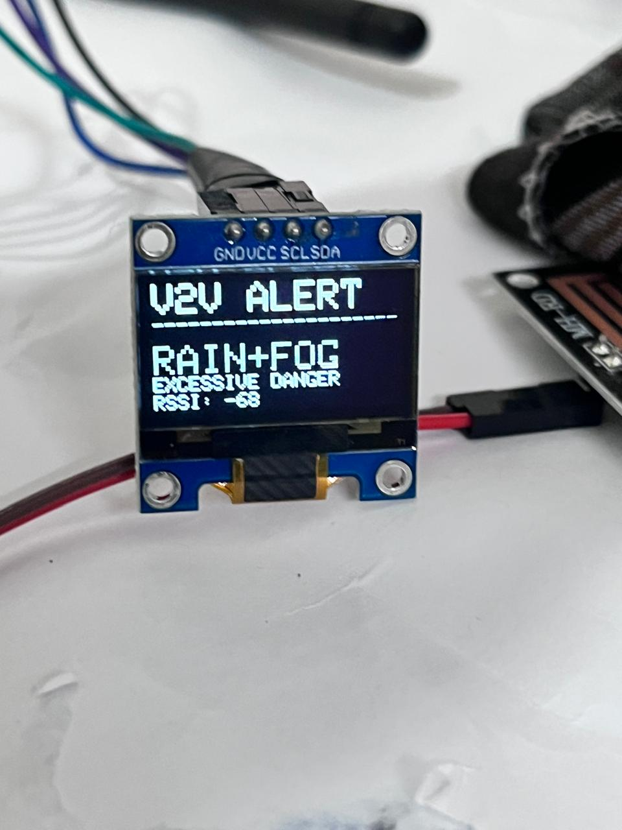


An Intelligent Multi-Sensor Windshield Monitoring Framework with UWB Actuator Control and LoRa-Based V2V Hazard Communication
A G Hretik Eashwar (RA2211004010521), Navin Kumar S (RA2211004010542), Abishek C (RA2211004010556), Dr. Arumbu V N (Assistant professor)
21ECP401L-Major Project
Department of Electronics and Communication Engineering, SRM Institute of Science and Technology, Kattankulathur
INTRODUCTION/ABSTRACT
REALISTIC CONSTRAINTS
CONCLUSION
Adverse weather conditions such as rain and fog significantly reduce driver visibility and increase the risk of road accidents. This paper presents a hybrid wireless smart windshield and vehicle-to-vehicle (V2V) safety system that automatically manages windshield visibility and provides real-time weather alerts to nearby vehicles. Rain and fog sensors interfaced with an ESP32 microcontroller continuously monitor environmental conditions to control windshield wiper operation and activate a heating element for fog removal. To reduce wiring complexity and improve in-vehicle reliability, Ultra-Wideband (UWB) communication using the ryuw122 module is employed for wireless sensor-to-actuator control. For inter-vehicle communication, LoRa based communication enables low-latency long-range V2V alerts, while LoRa communication extends alert coverage over longer distances. The suggested system is affordable, energy-saving, and scalable that predetermines its strong suitability to the transport systems of the future and intelligent vehicles safety systems.
Although the system improves safety, the LoRa-based V2V link and UWB in-car link can still be vulnerable to jamming, spoofing, or eavesdropping if proper security layers are not implemented.
The inclusion of multiple sensors, UWB, LoRa, and a camera increases hardware cost, but it is still more cost-effective than adopting full-fledged ADAS or radar– camera fusion platforms used in premium vehicles.
LoRa is suitable for low-rate hazard alerts, but its data rate and latency are limited; UWB offers high-speed, low-latency control only over short ranges inside the vehicle.
A smart windshield monitoring system using ESP32 with multi-sensor integration will be developed to enhance driver visibility and safety. The system is expected to automate wiper and defogger operations using real-time rain and fog detection.
UWB-based wireless communication will be implemented to enable reliable in-car control between the sensing module and the actuator module. LoRa-based V2V alerts will be added to improve situational awareness for nearby vehicles during low-visibility conditions.
An IR-based obstruction detection mechanism will be designed to identify sudden windshield blockage. A camera-triggering feature will be incorporated to provide real-time visual feedback when visibility is compromised.
The final prototype aims to achieve a compact, low-power, and scalable design suitable for automotive environments.
ENGINEERING STANDARDS
IEEE 802.15.4a/4z (UWB) for short-range, low-latency in-vehicle communication between sensing and actuator units.
LoRa/LoRa WAN specifications for long-range, low-power V2V safety alert communication.
Standard serial communication interfaces such as UART/SPI/I2C for interfacing ESP32 with sensors, UWB, LoRa modules, and camera-related hardware.
MOTIVATION
REFERENCES
Poor visibility due to rain, fog, and sudden obstructions is a major cause of road accidents
Manual control of wipers and defoggers increases driver distraction and reaction time
Existing systems lack intelligent automation and respond slowly to changing conditions
Absence of real-time detection and response to sudden windshield blockage (e.g., cloth, plastic)
No wireless communication between sensing and actuator units in low-cost systems
Lack of Vehicle-to-Vehicle (V2V) communication to alert nearby vehicles of hazards
Need for an integrated, smart, and low-power system to enhance overall driving safety
Fig 1: Overall System Block Diagram
[1] S. S. Patil and P. R. Patil, “Automatic Rain Operated Wiper System in Automobile Using Microcontroller,” International Journal of Engineering Research & Technology (IJERT), vol. 5, no. 5, pp. 1–4, May 2016.
[2] M. A. Hossain, M. R. Islam, and S. H. Shah, “Design and Implementation of Smart Windshield Wiper System Using Rain Sensor,” IEEE International Conference on Electrical, Computer and Communication Engineering (ECCE), 2019, pp. 1–5.
[3] A. Bazzi, B. M. Masini, A. Zanella, and G. Pasolini, “On the Performance of IEEE 802.11p and LTE-V2V for the Cooperative Awareness of Connected Vehicles,” IEEE Transactions on Vehicular Technology, vol. 66, no. 11, pp. 10419–10432, Nov. 2017.
[4] Z. Sahinoglu, S. Gezici, and I. Guvenc, Ultra-Wideband Positioning Systems: Theoretical Limits, Ranging Algorithms, and Protocols, IEEE Press, 2008.
[5] F. Adelantado, X. Vilajosana, P. Tuset-Peiro, B. Martinez, J. Melia-Segui, and T. Watteyne, “Understanding the Limits of LoRaWAN,” IEEE Communications Magazine, vol. 55, no. 9, pp. 34–40, Sept. 2017.
The experimental setup consists of two main configurations to validate both in-vehicle and inter-vehicle communication. In the first setup (Fig 2(a)), an ESP32-based sensing unit collects data from rain and environmental sensors and processes it to control actuators such as the wiper and defogger. This control is achieved wirelessly using UWB modules, enabling reliable communication between the sensing node and the actuator node within the vehicle. In the second setup, LoRa modules are used to establish Vehicle-to-Vehicle (V2V) communication, where visibility-related alerts generated in one vehicle are transmitted to a second vehicle (Fig 2(b)) and displayed to the driver. Together, these setups demonstrate real-time sensing, wireless actuator control, and long-range safety alert communication under different environmental conditions.
RESULTS & INFERENCE
The experimental results demonstrate that the system operated reliably across all tested conditions. The rain sensor effectively detected rainfall and promptly activated the servo motor, successfully simulating windshield wiper operation. Similarly, temperature and humidity data obtained from the DHT22 sensor enabled accurate identification of fog conditions, triggering the DC fan to simulate the defogging mechanism. During initial testing, the wired sensor-to-actuator control proved to be stable and dependable, ensuring correct system response. This was further enhanced by the successful implementation of UWB communication using the RYUW122 module, which enabled efficient and low-latency wireless control between the sensing unit and actuator unit within the vehicle. Additionally, the LoRa SX1278 module was properly interfaced and tested, facilitating reliable long-range data transmission for Vehicle-to-Vehicle communication. The system was able to generate and transmit visibility alert messages under various environmental conditions, including rain and fog scenarios (Fig 3(a/b/c/d)). Overall, the system exhibited stable and consistent performance across multiple test cases, validating its effectiveness for real-time monitoring, control, and safety alert applications.
PROBLEM STATEMENT/OBJECTIVE
To develop an ESP32-based smart windshield system integrating rain, fog, and IR sensors for automatic visibility monitoring and control.
To automate wiper, defogger, and obstruction-detection functions using real-time sensor data, including camera activation during visibility blockage.
To implement wireless communication using UWB for in-car actuator control and LoRa for V2V safety alerts in low-visibility conditions.
To enhance driver safety and reduce workload by delivering a compact, low-power, and reliable system suitable for all weather environments.
SUSTAINABLE DEVELOPMENT GOALS
SDG 3 – Good Health and Well-Being
Improves road safety by reducing accidents caused by poor visibility.
Minimizes driver stress through automation of wiper and defogging systems.
SDG 9 – Industry, Innovation and Infrastructure
Promotes innovation in intelligent automotive safety systems.
Integrates sensors and wireless communication for smart transportation.
SDG 11 – Sustainable Cities and Communities
Enhances safety in urban and highway transportation.
Supports development of safer and smarter mobility solutions
BLOCK DIAGRAM
Fig 2(a): Experimental Setup for UWB-Based Actuator Control
The system initializes the ESP32 microcontroller and connected peripherals
Rain sensor data is continuously monitored to detect rainfall conditions, Upon detection of rain, the servo motor is activated to simulate windshield wiper operation
Temperature and humidity values are obtained from the DHT22 sensor, When fog-prone conditions are identified, the Heating plate is activated to simulate the heating/defogging mechanism.
A visibility alert message is generated based on the detected conditions; The alert message is transmitted to nearby vehicles using the LoRa RYLR998 module.
The process is executed continuously to ensure real-time response.
Fig 3(a): Default
Fig 3(b): Fog Alert
CONFERENCE / JOURNAL PUBLICATION
2nd International Green Energy Mobility Conference (IGEM), Department of Automobile Engineering, SRM Institute of Science and Technology (SRMIST), Kattankulathur (KTR Campus), India, Apr. 9–10, 2026. (Presented)
Fig 2(b): Experimental Setup for UWB-Based Actuator Control
Fig 3(c): Rain Alert
Fig 3(d): Rain + Fog Alert

